Slide 1
A new primal dual method for fully nonconvex composite optimization
School of Mathematical Sciences, Beihang University, Beijing 100191, China.
Luxuan Li
3 Dec, 2024

Slide 2
CONTENT
1
Introduction
2
Method
3
Main Results
4
Discussion
2

Slide 3
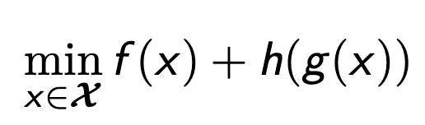
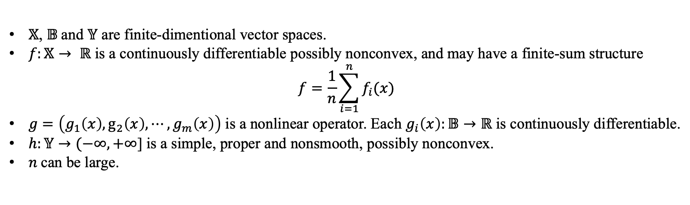
Introduction
Composite nonconvex nonsmooth finite-sum optimization problem
$𝕏$, $𝔹$and $𝕐$ are finite-dimentional vector spaces.
$f:𝕏→ ℝ$ is a continuously differentiable possibly nonconvex, and may have a finite-sum structure
$$f=\frac{1}{n}\sum_{i=1}^{n}{f_{i}(x)}$$
$g=\left(g_{1}\left(x\right), g_{2}\left(x\right), ⋯, g_{m}\left(x\right)\right)$ is a nonlinear operator. Each $g_{i}\left(x\right):𝔹→ℝ$ is continuously differentiable.
$h:𝕐→(−∞, +∞$] is a simple, proper and nonsmooth, possibly nonconvex.
$n$can be large.
Challenges
Nonconvexity of the problem
The coupling between a nonlinear operator and a nonsmooth function
The inefficiency of computing the proximal operator of $h∘g$
3

Slide 4
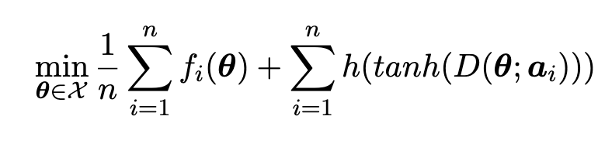
Introduction
Deep pairwise supervised hashing
$f_{i}$ is the loss function, preserving the similarity between hamming space and input space.
$h:𝕐→(−∞, +∞$] is the binary hash regularization, which usually has the binarization approximation properties at -1 and 1.
$n$can be large.
4

Slide 5
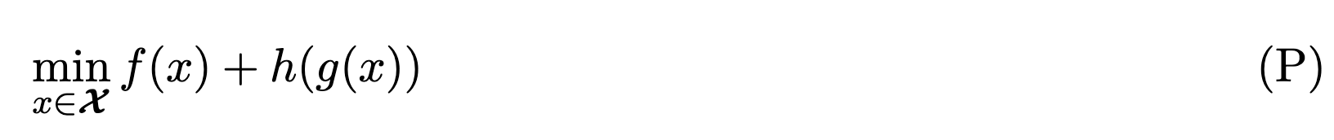
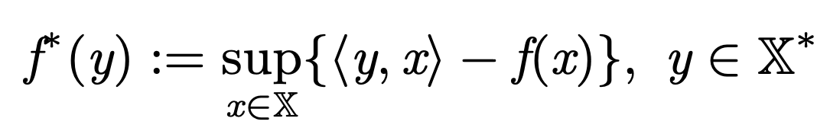
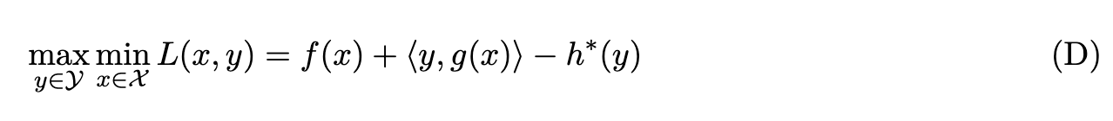
Method
Primal problem:
Dual problem:
5

Slide 6
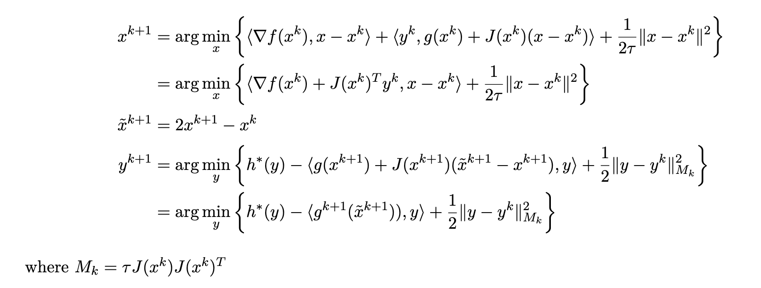
Method
For the update of $x$, the nonlinear opeator $g\left(x\right)$ is linearized at $x^{k}$, and $J(x)$is the Jacobian matrix；
For the update of $y$, , the nonlinear opeator $g\left(x\right)$ is linearized at $x^{k+1}$.
6

Slide 7
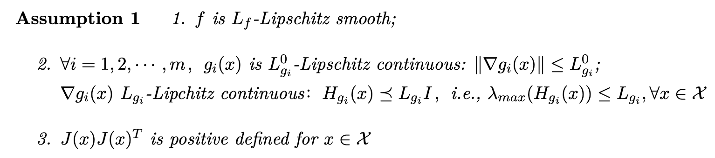
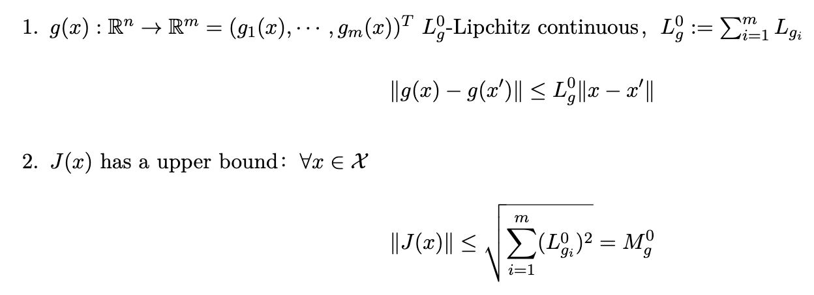
Main Results
Main Assumptions
Here, we obtain:
7

Slide 8
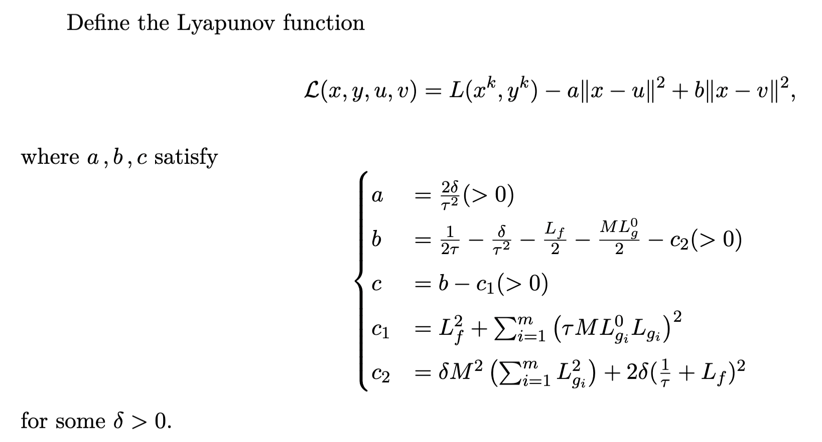
Main Results
8

Slide 9
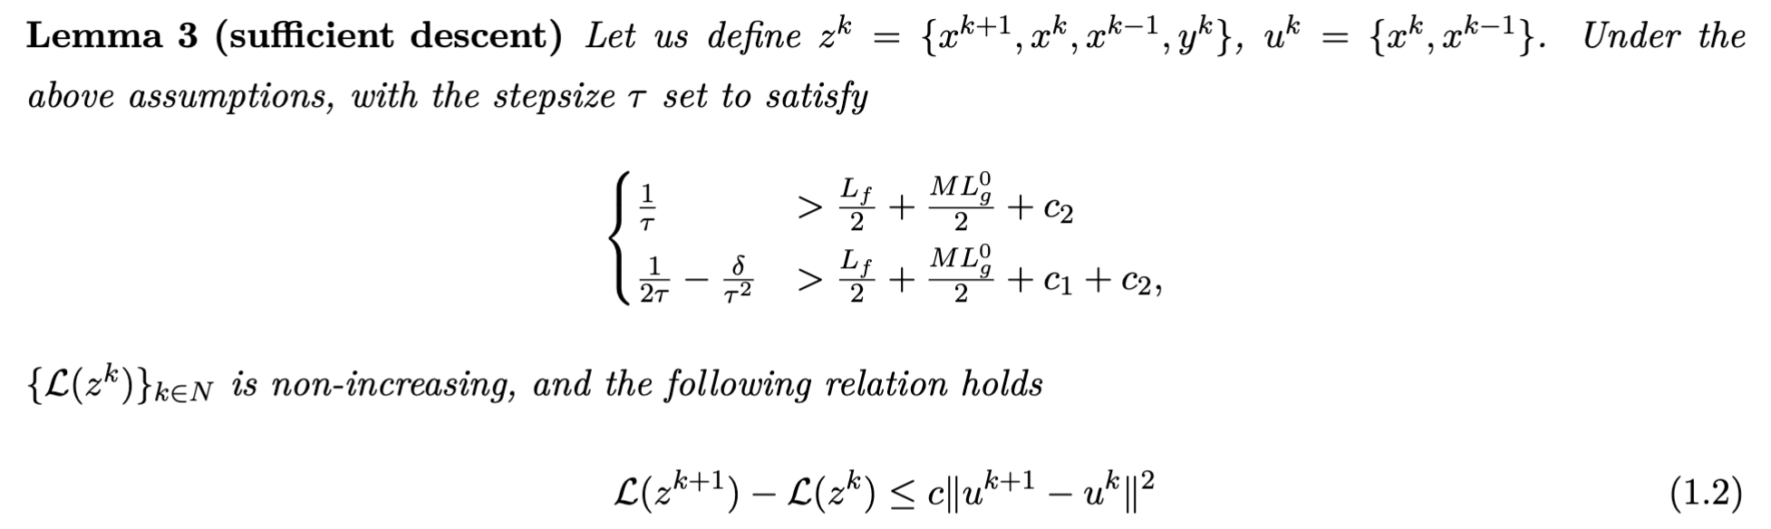
Main Results
9

Slide 10
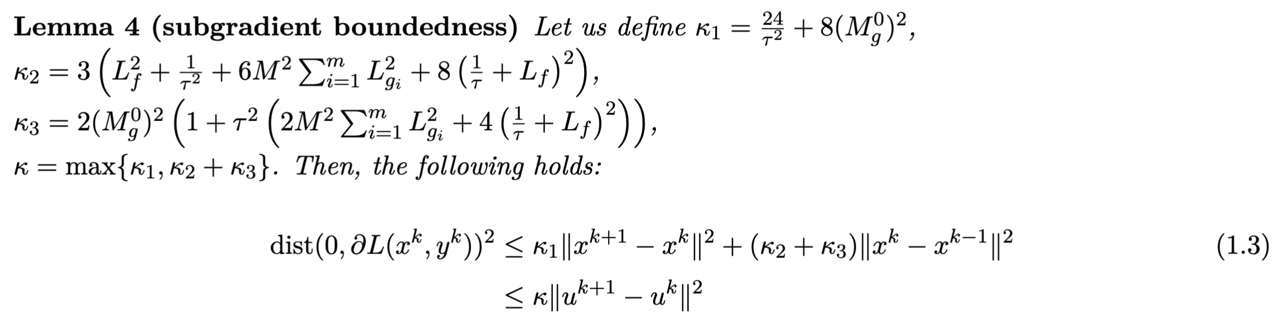
Main Results
10

Slide 11
Results
Discussion
假设可否减弱？
是否可以做随机及加速推广？
数值效果暂时未知。
11
Notes:
第一点：minmax 和 maxmin 的区别？后者是对偶问题，但是交替极小化的时候，先更新对偶变量和先更新原始变量没有区别；
第二点：也就是说，这个正则项，换成另外其他的非凸正则项，只要共轭邻近算子可以求，就都可以用这个算法，并没有很好地体现哈希正则项的特色。

